Slide 1
TeacherTesters
Teachers - grading the tech they might use

Slide 2
EdTech Market
8 billion dollar industry
With 2 billion in news deals
800+ companies
3 million US teachers
Notes:
Problem: People aren’t investing their money in socially responsible ways. Lack of awareness of socially responsible investing.

Slide 3
Market gap
Companies need product testing from teachers
Teachers have great insights but no time - or money ;)

Slide 4
Solution
$60/30 min. - Product beta testing
$120/hr. - Follow-up interview calls
$25 - Quantitative survey
Panel of vetted teachers

Slide 5
Validation
Companies want it!
“I wish we had this when we started, and we would probably still use it.” - Dan Carroll, CPO of Clever
3/3 tech executives gave their thumbs up.
Teachers want it!
“For $100 an hour, I would answer questions in this space all day long” - Teacher
8/8 teachers gave an “absolute yes.”

Slide 6
What do companies get?
Consistent quality feedback
Agility in product development
Cheaper fees than consultants

Slide 7
What do teachers get?
Money on the side
Privacy
Influence over new tools

Slide 8
What do we get?
25% on top of teacher payment
$100/month panel access fee

Slide 9
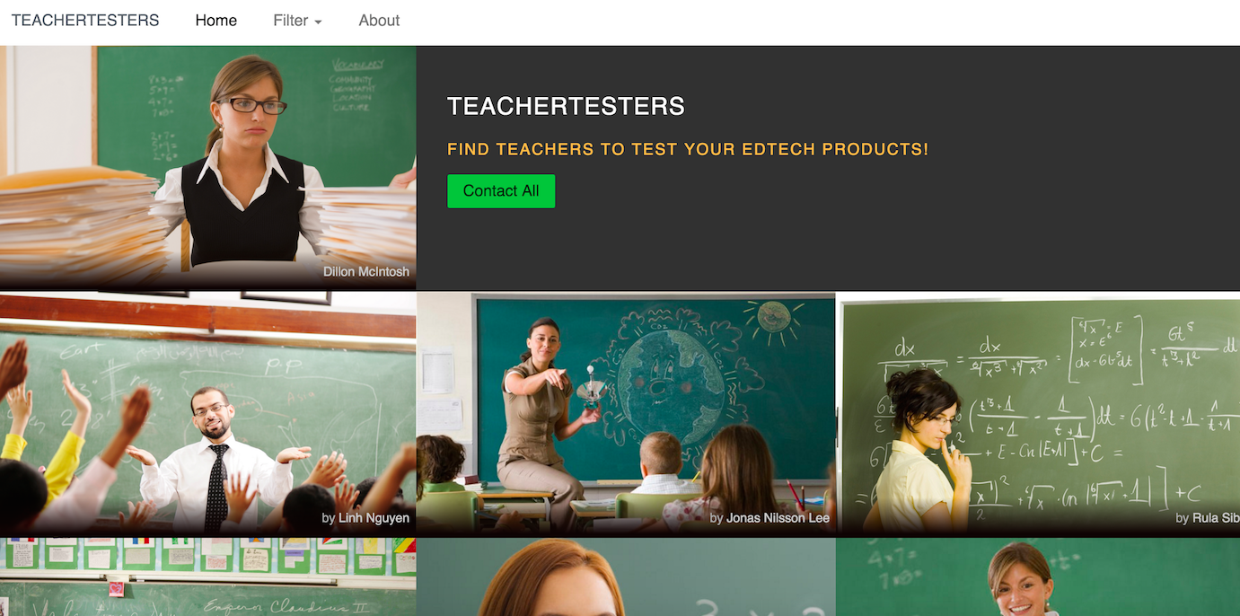

Slide 10
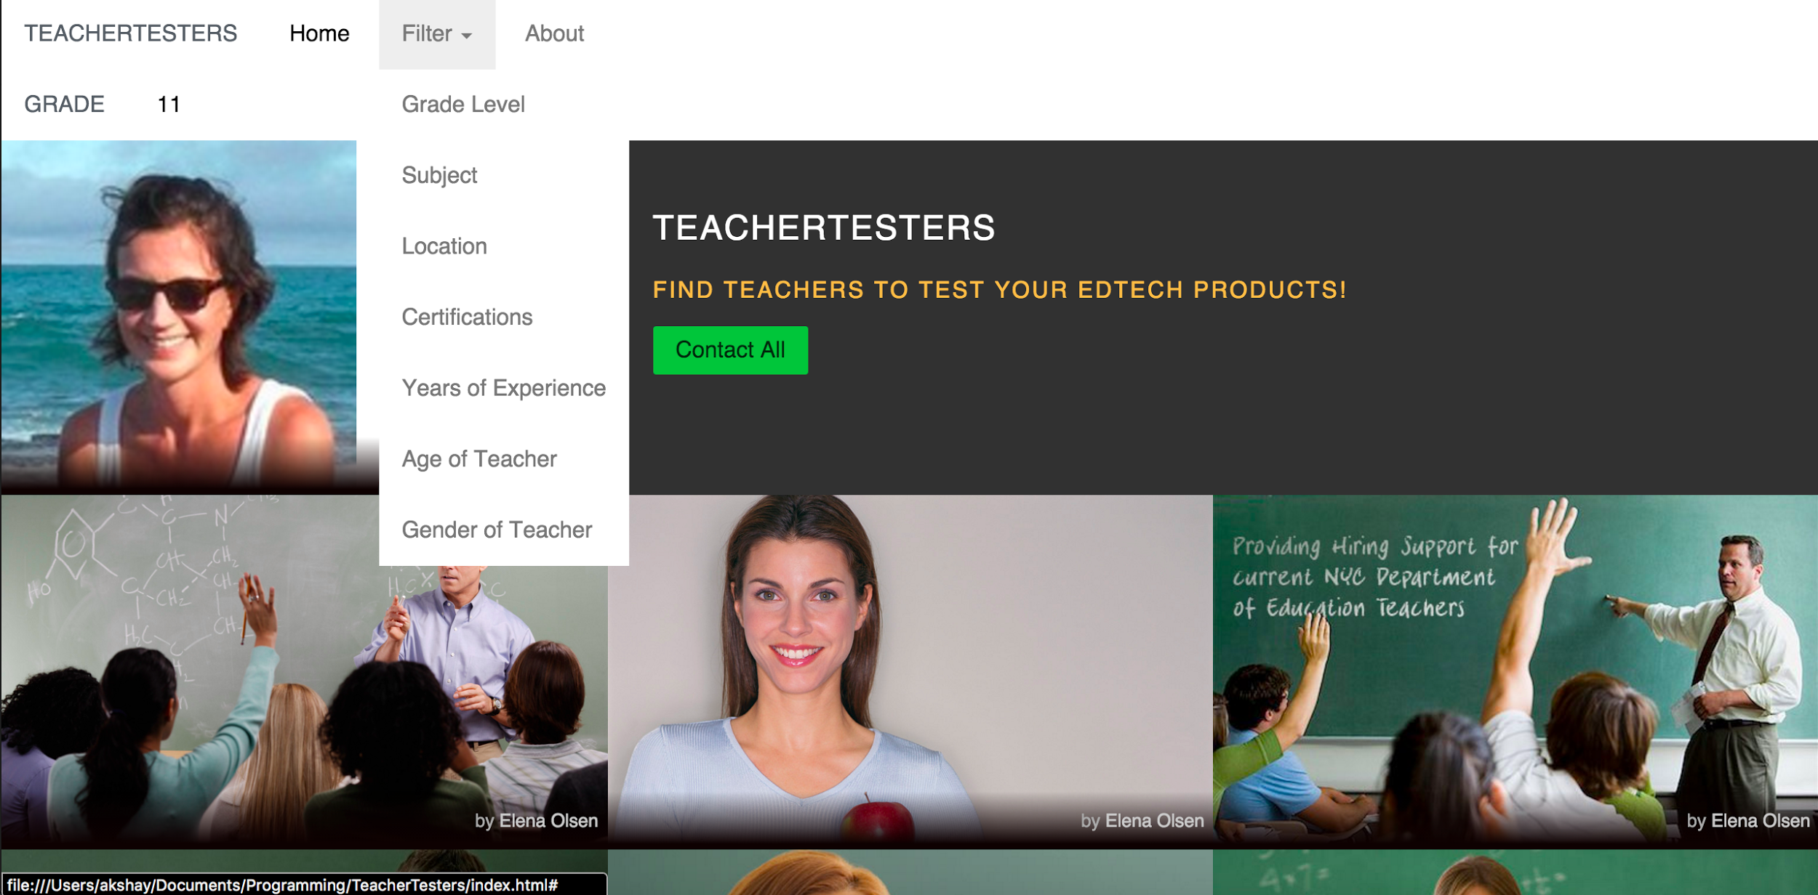

Slide 11



Competitors
Consumer Product Ninja
Traditional Market Research and Consulting Firms
Apple TestFlight

Slide 12
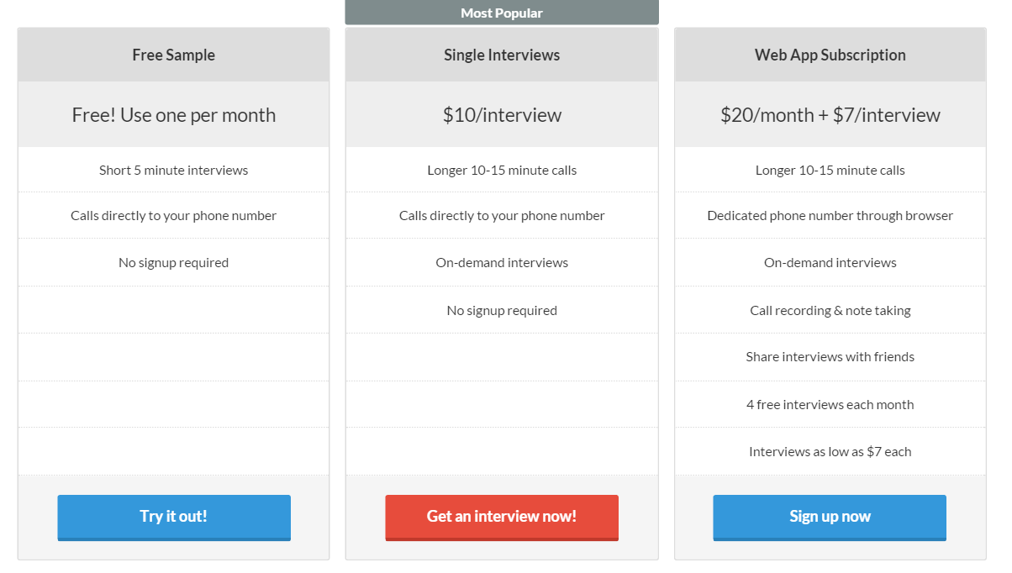
Competitor - Consumer Discovery Ninja

Slide 13
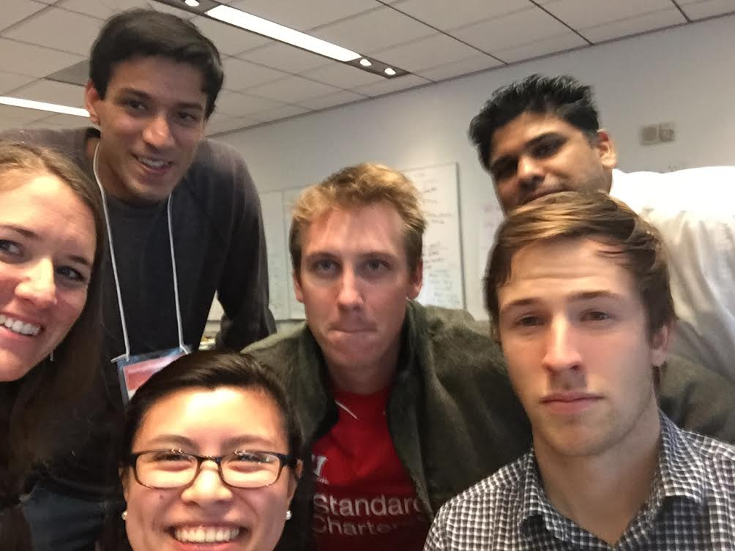
Team

Slide 14
TeacherTesters
Teachers - grading the tech they might use

